Slide 1
CAPSTONE PROJECT
SPORTS ANALYSIS

Slide 2
OBJECTIVE
Visualizing the sports information in the creative dashboard
Analyze the evolution of Olympic sports over the years.
Highlight key details of games, sports, and events.
Showcase host cities, countries, and their cultural significance.
Explore data on athletes, medals, and achievements.
Celebrate the spirit of global unity and athletic excellence.

Slide 3
DATA DICTIONARY
SPORTS
This table contains a comprehensive list of all sports featured in the Olympics, covering both the summer and winter editions.
EVENTS
The Event table offers detailed information about the various events held within each sport. And event conclude the Men’s as well as women’s Event.
CITY
This table provides an extensive list of cities from around the world that have hosted or participated in the Olympic Games over the years.
GAMES
The Games table includes essential details such as the year in which the Games were held, as well as distinguishing between Summer and Winter Olympics.
GAMES CITY
This joining table Games and City tables, capturing instances where the Olympic Games were jointly hosted by multiple cities.

Slide 4
NOC REGION
This table consists of NOC codes, representing National Olympic Committees, and their corresponding countries also show the participation of the country.
PERSON
The Person table records information about individuals who have competed in the Olympics such as name, weight, height, id.
MEDAL
A table listing the different types of medals awarded at the Olympics, including Gold, Silver, Bronze, and N/A (indicating no medal).
COMPETITOR EVENT
This table represents providing crucial details about the combination of competitors, the events they participated in, and the medals they received.
GAMES COMPETITOR
This table serves as a joining table Olympic Games and showcasing the participants.
PERSON REGION
This joining table individuals and the countries they represented while competing in the Olympics.

Slide 5
POWER BI
Sports analysis Report

Slide 6

SPORTS ANALYSIS REPORT
EVENTS ANALYSIS
GAMES ANALYSIS
MEDAL ANALYSIS
ATHELETS ANALYSIS
REGION ANALYSIS
SEASONANALYSIS

Slide 7
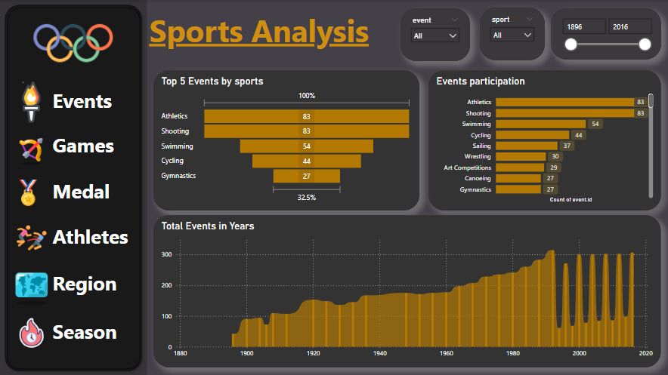
EVENTS ANALYSIS

Slide 8
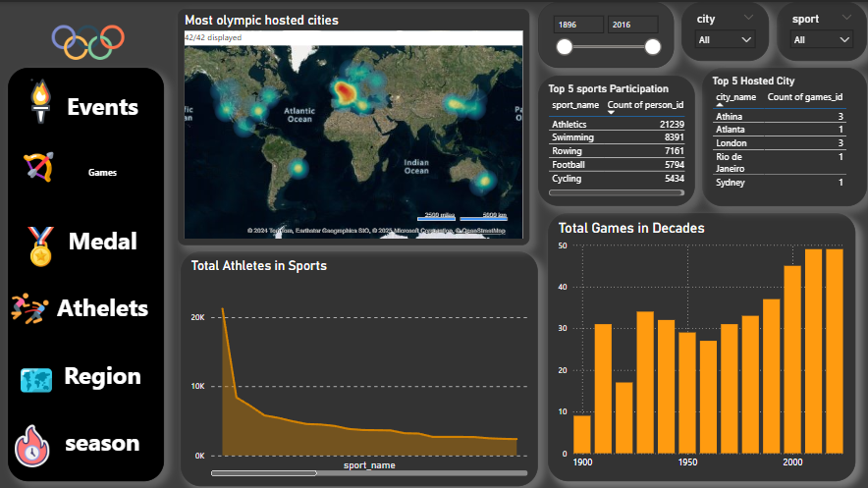
GAMES ANALYSIS

Slide 9
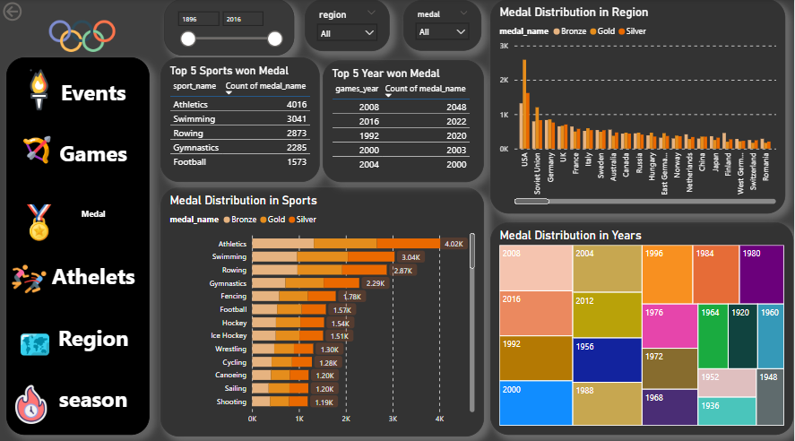
MEDAL ANALYSIS

Slide 10
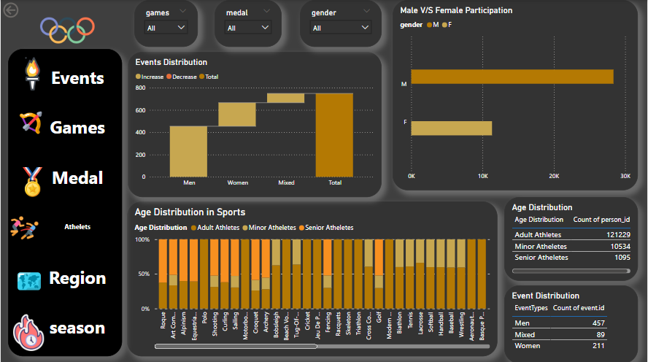
ATHLETES ANALYSIS

Slide 11
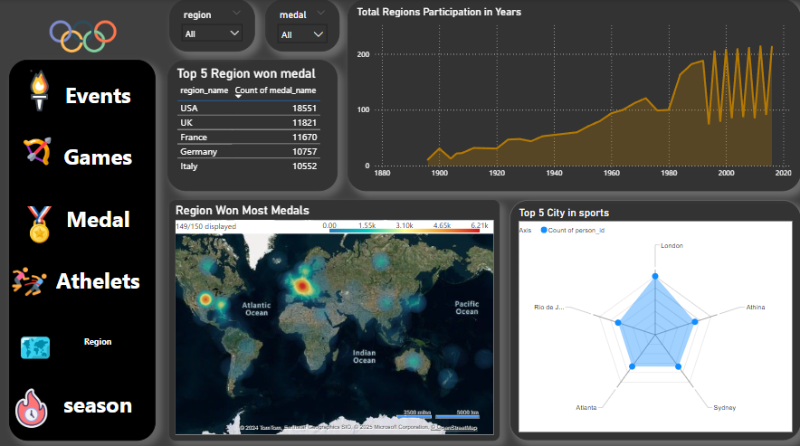
REGION ANALYSIS

Slide 12
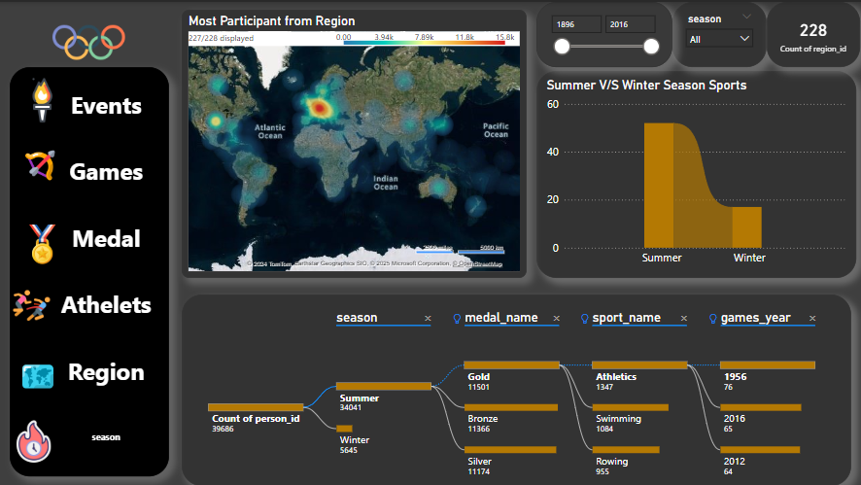
SEASON ANALYSIS

Slide 13
EXCEL
Sports analysis Report

Slide 14
EXCEL SPORTS ANALYSIS REPORT
EVENTS ANALYSIS
GAMES ANALYSIS
MEDAL ANALYSIS
ATHELETS ANALYSIS
REGION ANALYSIS
SPORTS ANALYSIS

Slide 15
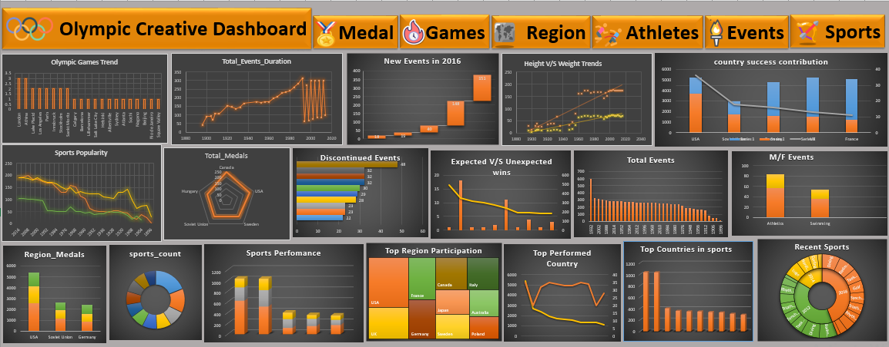

Slide 16
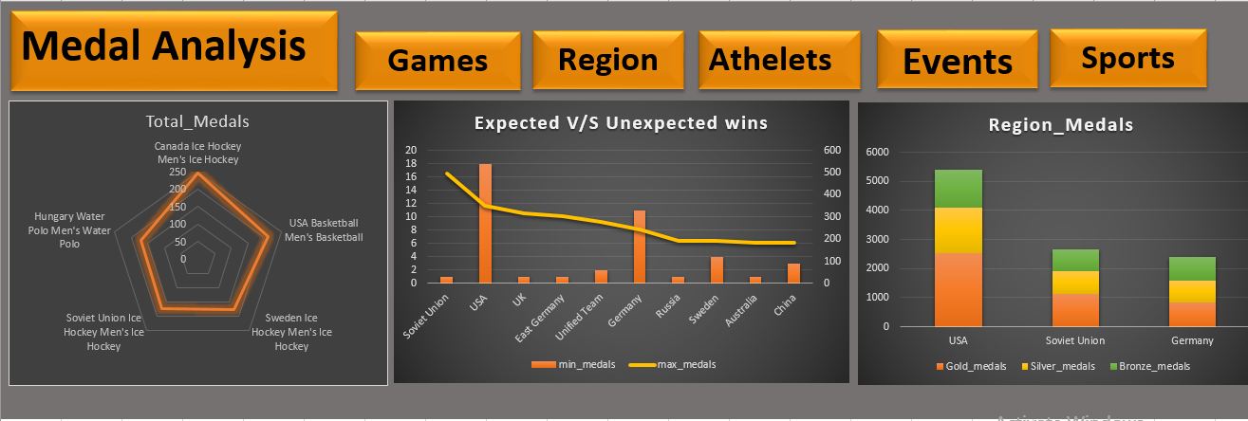

Slide 17
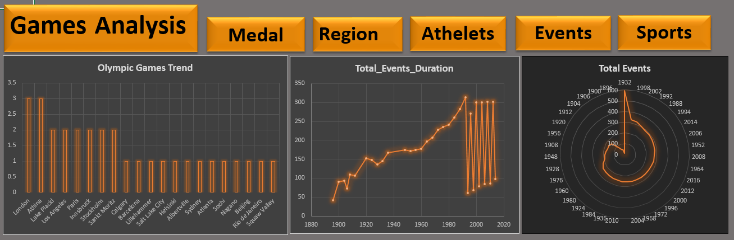

Slide 18
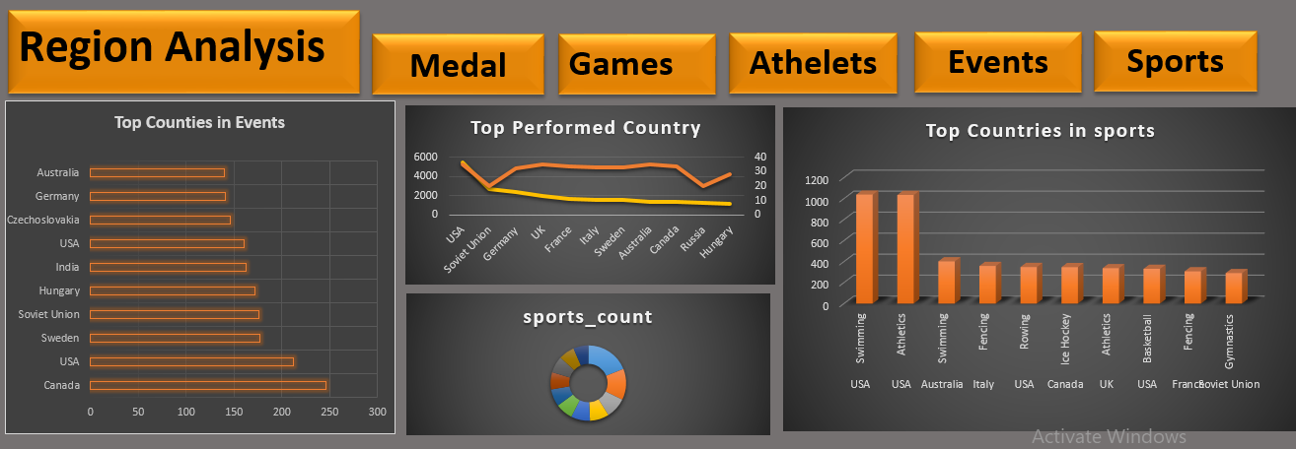

Slide 19
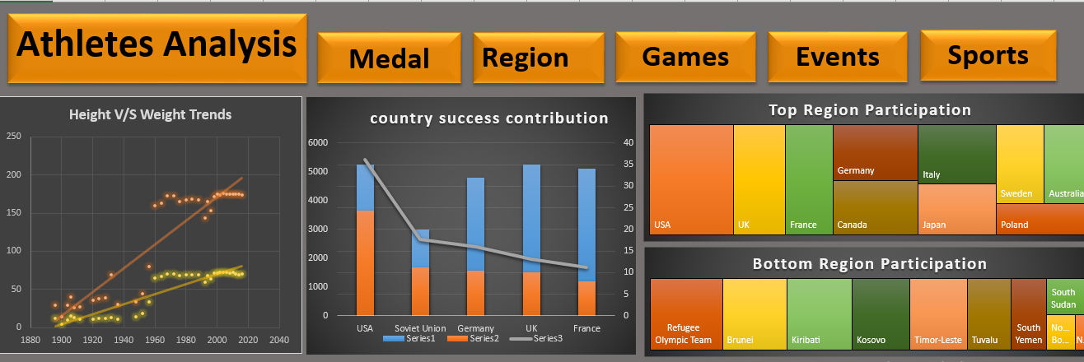

Slide 20
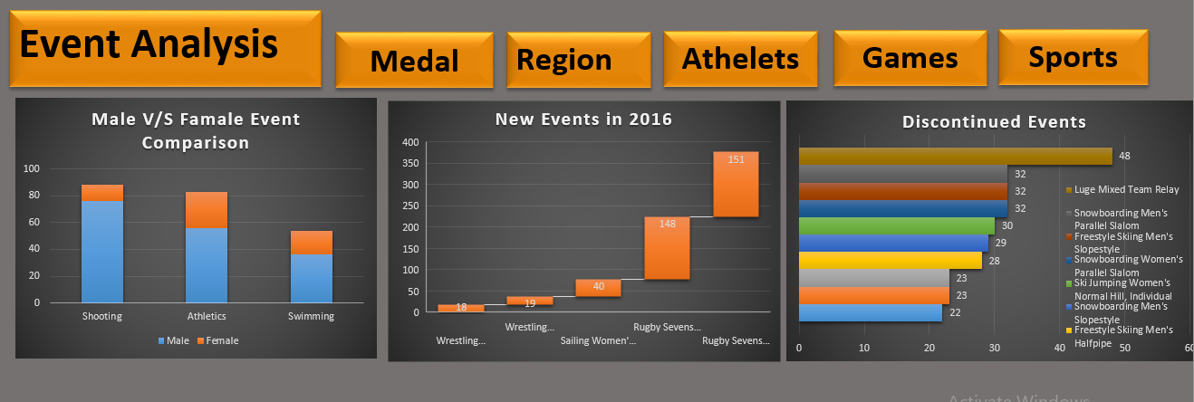

Slide 21
